Slide 1
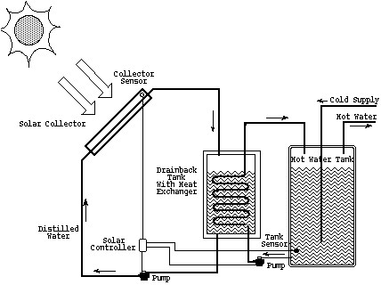
Solar Water Heating Systems
Dr. Bharat Sutaria

Slide 2
Topics Overview
Types of heating systems
Hardware
System applications
Financial analysis & Economics
Recommendations
Case studies

Slide 3
Advantages
Simple to construct and install
No or negligible running coast
Almost maintenance free
Cost is low & economically competitive with electric water heating systems
It saves time and high grade form of electric energy
Require the low temperature up to 100 ⁰C can be achieved by simple flat plate collector.

Slide 4
Four Types of Heating Systems
Natural circulation or thermo-syphon solar water heaters
Forced circulation solar water heating system
Direct or Open Loop System
Indirect or Closed Loop System
Active System
Passive System

Slide 5
Open & Closed Loop Design Characteristics
Open Loop System
Closed Loop System
Solar heated water flows directly into existing water heater, or secondary storage tank
Used in household and pool applications
Water flowing across panels is what comes out of the faucet
Antifreeze (glycol) is used along with a heat exchanger to transfer heat
More common in household applications
Liquid flowing across panels does not mix with faucet water

Slide 6
Open Loop System Comparison
Advantages
Disadvantages
Less expensive type of system, no heat exchanger implementation
Easier to interface with current system
Good efficiency
Good for warm climates where freezing is unlikely
System can freeze in cold climates
System can overheat
Pipes do not completely drain when not in use
Repair is expensive!
May be more difficult to fit to existing system

Slide 7
Closed Loop System Comparison
Advantages
Disadvantages
Will not freeze
Will not overheat
Good for cooler climates where freezing is likely
Pipes drain when system it not working
Must purchase antifreeze
Must implement heat exchanger
May be more difficult to fit to existing system

Slide 8
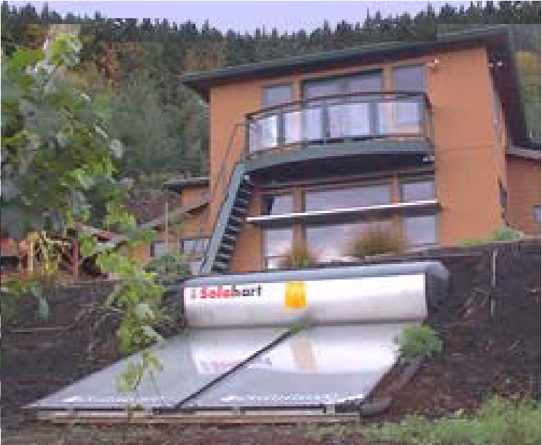
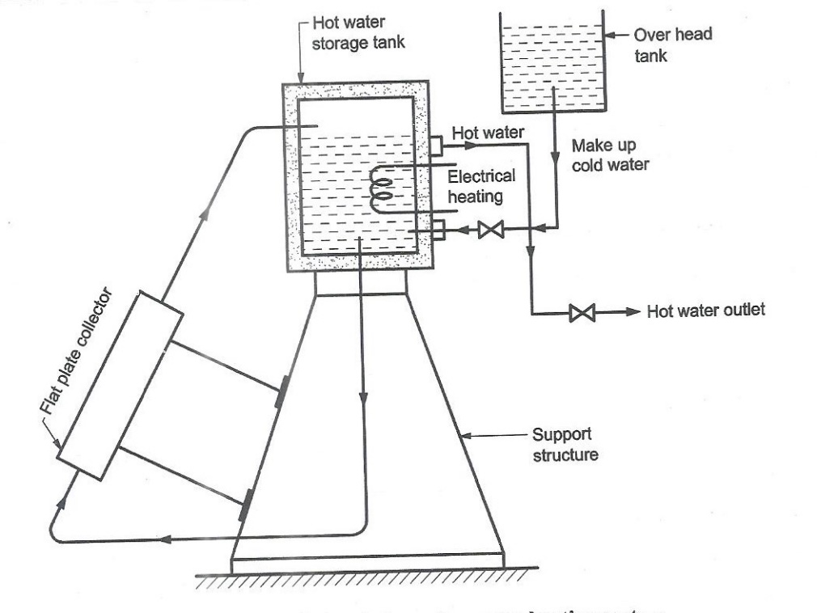
Passive Systems
Simple, small capacity
( up to 200 liters)
Main components are:
Flat plate collector, hot water storage tank, over head tank and supporting structure, piping, elbow, valve etc.
Very heavy & Ugly to look at
Will not freeze
Utilizes thermo-syphon
Not very efficient—especially in low intensity sunlight

Slide 9
Flat plate collector is installed facing south at an inclination equal to the latitude of the place of installation.
Well insulated water tank with pipe having thick insulation are connected at the two ends of the flat plate collector.
Tank is placed 30-60 cm height relative to top of solar collector.
Supply a cold water as make up water from over head tank to the hot water storage tank.
Entire system is well supported on a structure.

Slide 10
As water is heated in the flat plate collector due to incident solar radiation, hot water rises up and flows naturally to the storage tank due to decrees in its density.
Colder water from the bottom of storage tank having higher density replace the hot water.
Thus density difference of hot and cold water provides a driving force to setup natural convection for circulation of water through a storage tank and the solar collector.
Passive system does not need any mechanical device to circulate the water in the systems.
To provide hot water during long cloudy periods or rainy days an electrical heating system is provided as back up systems.
It is more necessary particular in place having cold climates where solar radiations are low.

Slide 11
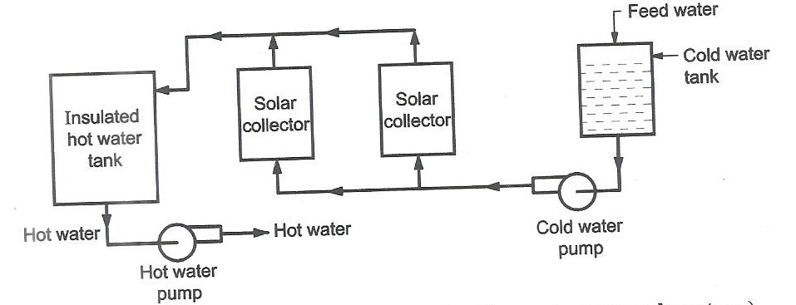
Force circulation water heating system (open loop)
Component of the systems are cold water tank, pump, array of the solar collectors, insulated hot water tank and pump
Cold water is pumped from cold water tank to solar array of solar collector.
The heated water from collectors flows into the insulated hot water tank from where it is drawn with the help of the pump for use.
Proportional flow controllers are used to vary the pump speed so that the hot water flows out at the required temperatures from the solar collectors.

Slide 12
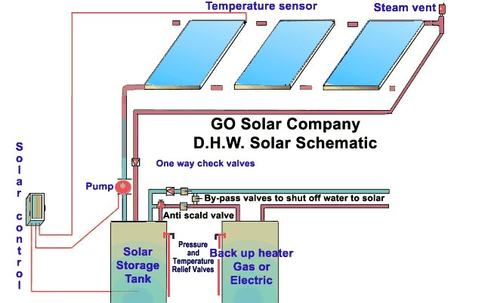
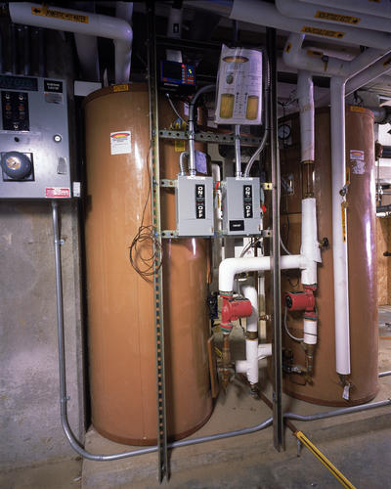
Open Loop System
Household Application
Solar heated water runs directly into a secondary storage tank, or an existing hot water heater.

Slide 13
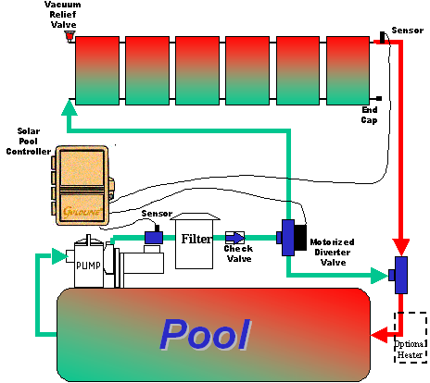
Open Loop System
Swimming Pool Application
Open loop drain back systems pumps pool water up to panels and gravity brings it back down

Slide 14
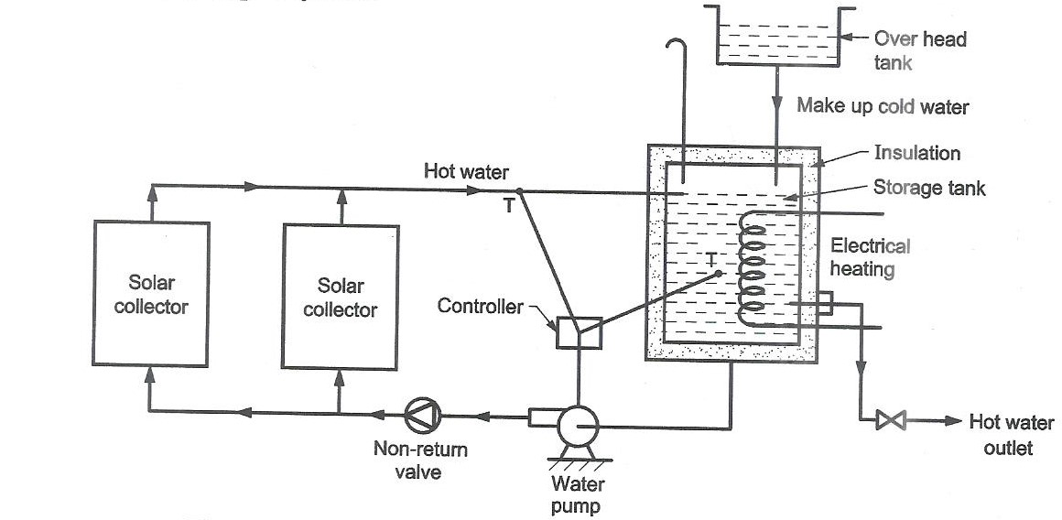
Force circulation solar water heating systems (closed loop)

Slide 15
Forced circulation solar water heating system
When hot water requirements are large as in case of hotels, hospitals etc. Natural water systems are not suitable.
Forced circulation system is active system which uses a mechanical pump to circulate the hot water. Advantage of systems is that hot water tank place any convenient location.
Pump is generally controlled by electronic differential controller which stops and starts at predetermined temperature differential between the solar hot water temperature in the storage tank and solar collector outlet temperature.
Water from storage tank is pumped through an array of solar collectors. When water gets heated in the collector, it flows back into storage tank.
Non return valve is provided in the solar collector to prevent the reverse flow of hot water through the cold solar collector at night.
Presently solenoid operated ball valves are preferred which operate only when pump is under operation.

Slide 16
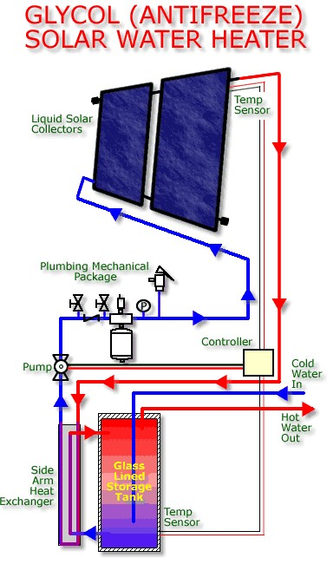
Closed Loop System
Household Application
Closed loop system in which glycol is heated and circulated through a heat exchanger to transfer heat to water

Slide 17
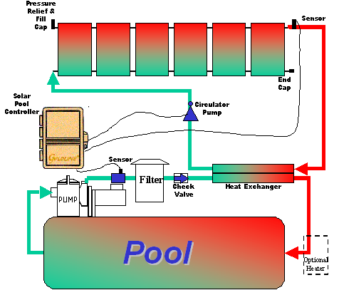
Closed Loop System
Pool Application
Closed loop systems prevent chemically saturated pool water from coming in contact with solar panels.

Slide 18
Hardware Components
Heat Exchanger
Solar Panels
Differential Controller
Glycol (antifreeze)
Circulation pump
Pipes & Sensors

Slide 19
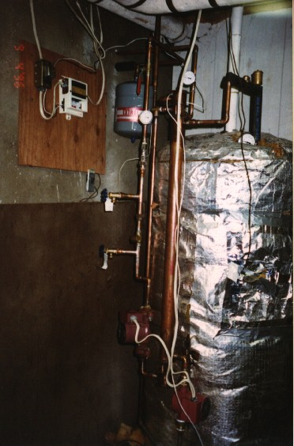
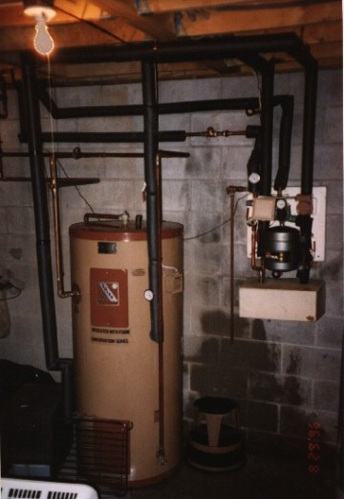
Heat Exchangers
Used to transfer heat from exchange medium to water

Slide 20
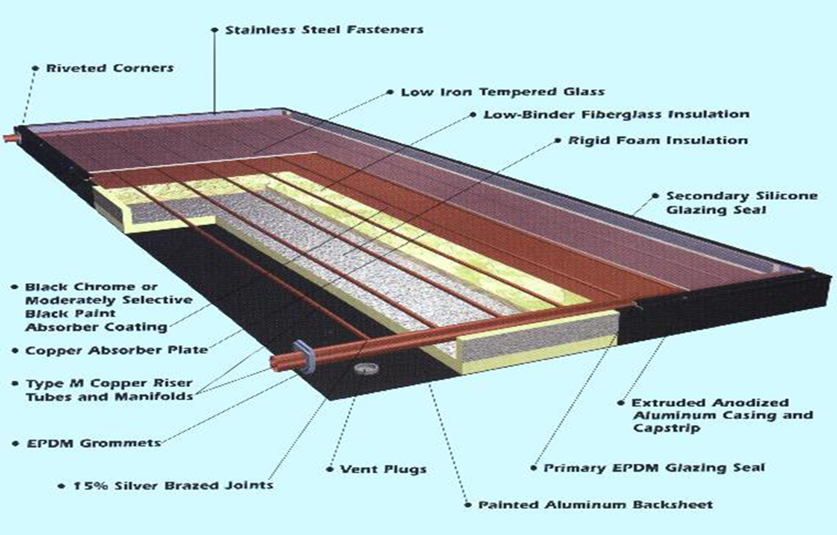
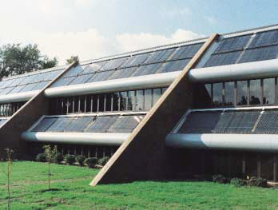
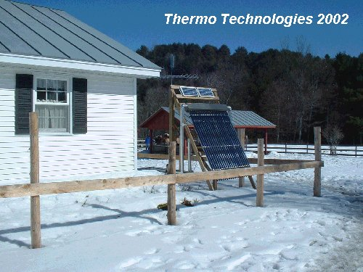
Solar Panels
Futuristic looking
Cold day in Vermont

Slide 21
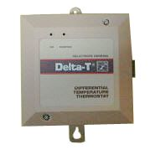
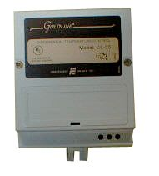
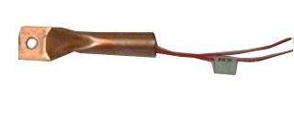
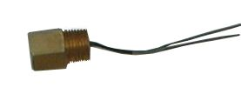
Differential Controllers & Sensors
Differential Controllers allow flow of solar heated water into storage tank if temperature differential is within a specified range.
Differential Controller
High temp. differential controller
Sensors relay water temperature data to controller which determines if solar heated water should be circulated to raise water temperature.
Bolt-on sensor
Screw-in sensor

Slide 22
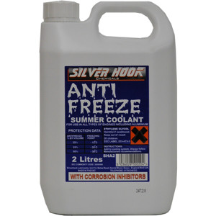
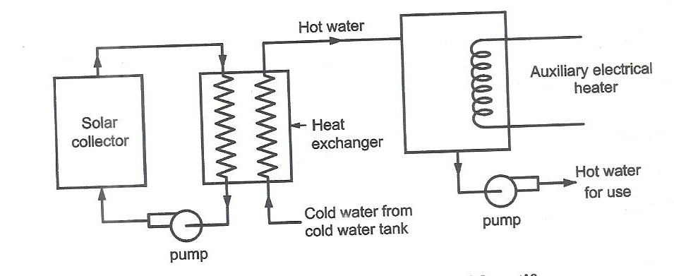
Glycol (Antifreeze)
To avoid the freezing of water in pipe
Protect the systems due to freezing (1) to drain water from collector manually through the gate valves provided at the bottom of solar collector or permit the reverse flow of hot water from storage tank at night at very slow rate. (2) by use of anti freeze solution
Make sure your antifreeze has corrosion inhibitors!
Unless you wish to shorten the life of your system.

Slide 23
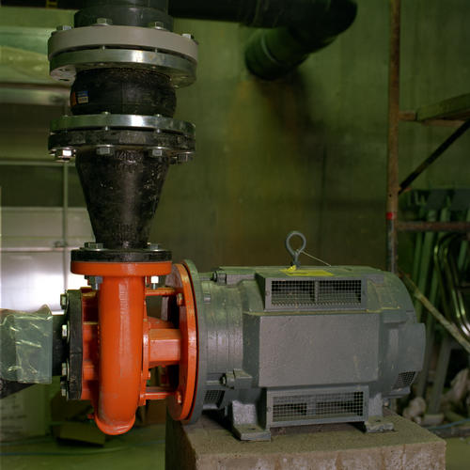
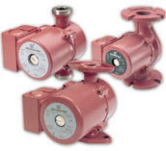
Circulation Pumps
Industrial size pump
Residential pumps
Pumps circulate water through solar panels. They are activated by the differential controller when it senses too large a differential between hot water supply and water coming from panels.
Two types of pumps: AC & DC

Slide 24
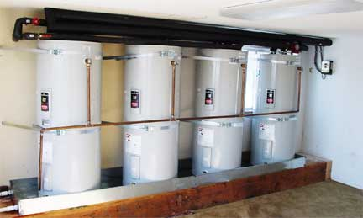
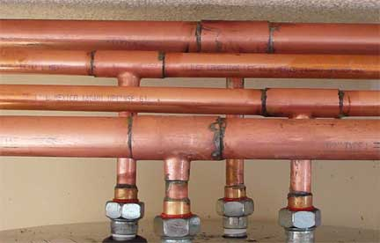
Pipes
Pipes should be well insulated to maximize efficiency
Preferably made from copper

Slide 25
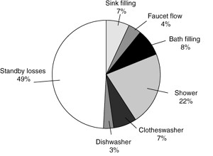
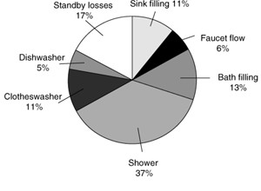
Domestic Hot Water Heating Statistics
Energy losses in electric water heaters
Energy losses in gas water heaters

Slide 26
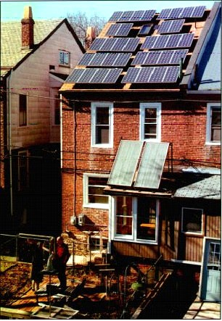
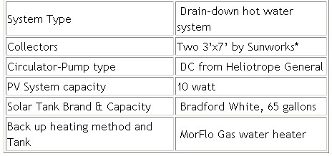
Case Study #1
Joyce & Andy
Melrose Park, PA.
Two 3’x7’ roof mounted drain-down solar hot water collectors provide hot water on sunny days. On cloudy days a gas hot water heater is available to assist if needed. A water submeter measures all domestic hot water. A gas submeter measures all gas used by the MorFlo water heater

Slide 27
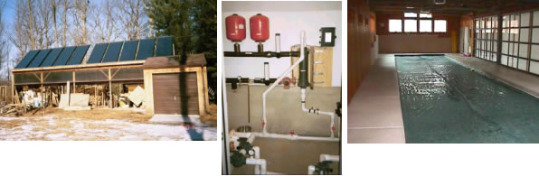
Case Study #2
Gaithersburg, MD.
This 400 square foot array heats an indoor swimming pool in Gaithersburg saving the owner substantially on her propane bill each month. The array was originally to be located on the roof of the pool house, but we chose to locate it on top of a 50 foot storage shed about 170 feet from the house. Pipes were trenched from the array to the pool pump room where the solar heat is transferred to the pool water via heat exchanger.

Slide 28
Conclusion & Closing Thoughts
Solar heating is efficient
Pays for itself in less time than any PV systems
Tax incentives are more appealing PV systems
Carefully consider your times of hot water
consumption

